Slide 1
Architecture

Slide 2

Introduction
Pre-Requisites
Developer Certification
My-trains project

Slide 3
Anypoint Platform
Hybrid, Highly productive enterprise integration platform
Mule runtime
Web application suite
Studio

Slide 4
Architecture Concepts
Enterprise Architecture
TOGAF / Zachman / 4+1 view point / DoDAF (Department of Defense Arch Fwrk) / FEAF (Federal Enterprise Arch Fwrk)
API Led Connectivity
Integration Architecture
Service Oriented Architecture
Event Driven Architecture
Extract Transform Load
…..

Slide 5
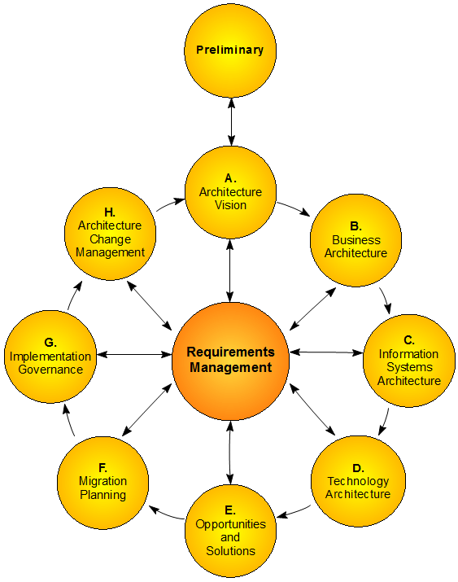
TOGAF

Slide 6
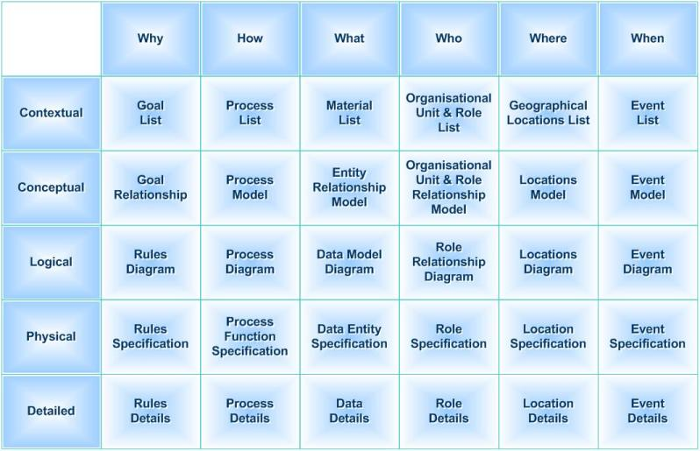
Zachman

Slide 7
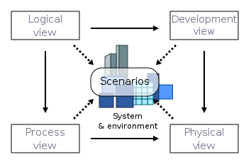
1+4 View point
Logical view: End user perpective
Development view: programmers perpective
Process view: run time behavior of the system
Phyical view: Infrastracture perpective
Scenario: Set of use cases

Slide 8
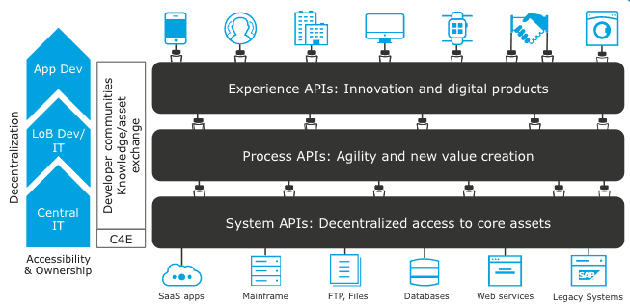
API-LED-Connectivity
Discoverability
Self-service
Reuse of well-designed
Well-managed APIs

Slide 9
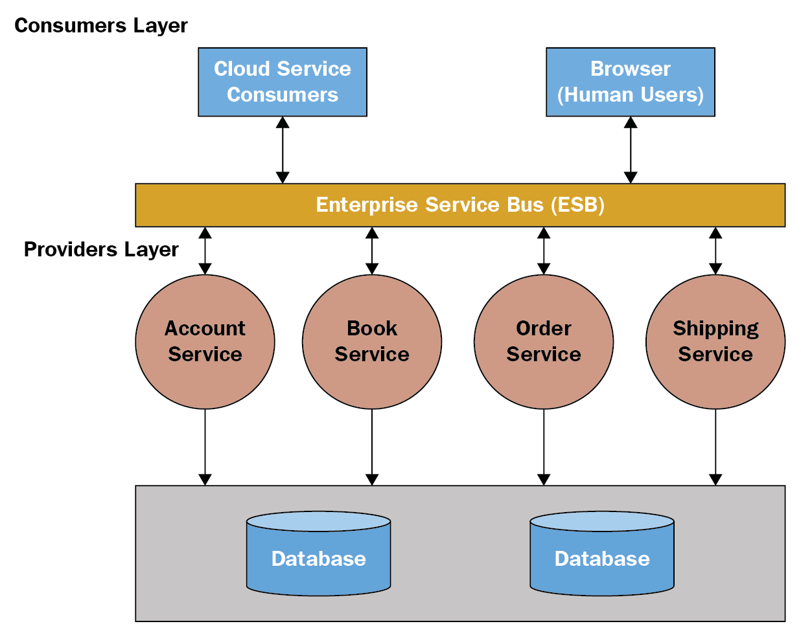
SOA
Loosely Coupled
Platform Independence
Reusable

Slide 10
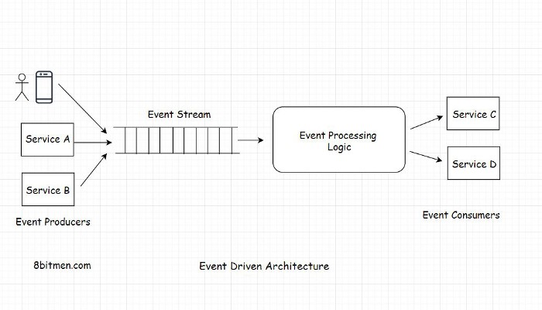
Event Driven Architecture
Concurrent connections
Asyncrounous
Minimal resource consumption

Slide 11
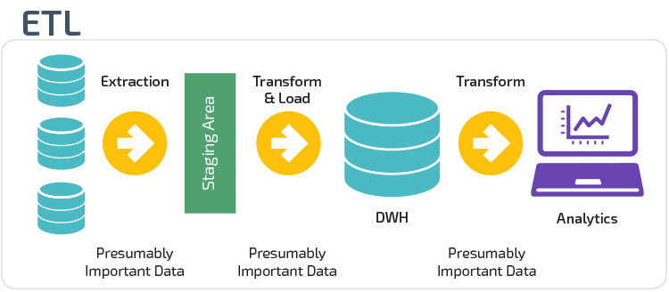
Extract, Transform, Load
Synchronizing data
Asynchronous Run
Difficulties:
Late arriving Rows.
Mixed Dimensions
Duplicates.
Schema changes of Source and Target entities.
Data Quality.

Slide 12
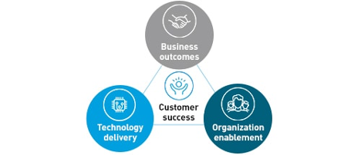
MuleSoft Delivery Approach
Catalyst Program
Designed to deliver customer success
How? - Using mulesoft’s Outcome-Based Delivery (OBD) methodology of aligning to three core pillars:
Business Outcomes
Technology Delivery
Organisational Enablement

Slide 13
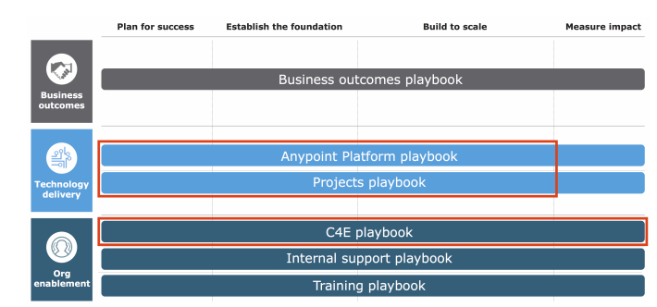

Slide 14
Diagramming Tools
Archimate
UML (Unified Modeling Language)
FMC (Functional Modeling Language)

Slide 15
Exercise
Requirement Analysis
Diagramming - use case
Diagramming - UML
API Led connectivity - Archimate

